Slide 1
Transfer Functions Architecture
HBP – Neurobotics Project

Slide 2
Requirements
Neurons occasionally send spikes
Transfer into continuous robot messages
Robot continuously or spontanously sends messages
Transfer into spikes for set of neurons
No assumptions on spike generation patterns
Support for common spike generation patterns such as fixed frequency or Poisson-based
Transfer functions in both directions may hold a state
Specification of Transfer Functions in Python or C++

Slide 3
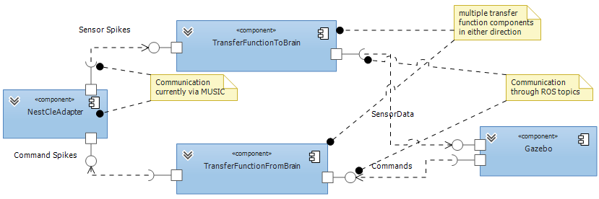
Architecture Overview

Slide 4
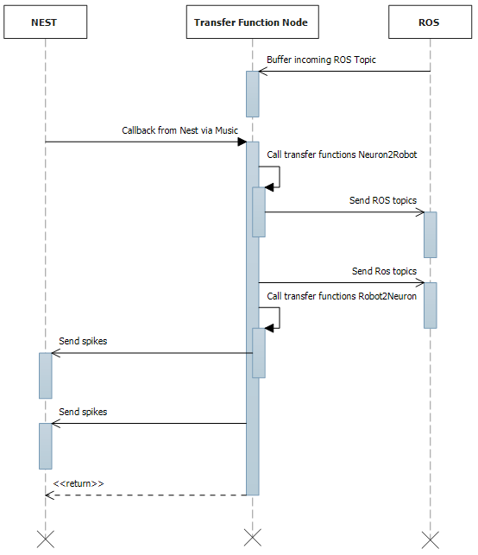
Iteration of a TF node

Slide 5
Python Prototype

Slide 6
C++ Prototype

Slide 7
API Proposal
Purpose | Python | C++
Register a transfer function to transform spikes into messages for the robot | Neuron2Robot decorator | TransferNeuronsToRobot, TransferNeuronToRobot
Register a transfer function to transform robot messages into spikes | Robot2Neuron decorator | TransferRobotToNeuron, TransferRobotToNeurons
Register that a transfer function will read spikes from a neuron | Inferred by the parameter name of a function, or explicit MapNeuronParameter annotation | One neuron with the registration, others via RegisterReadNeuron
Register that a transfer function will generate spikes to a neuron | Parameters of Robot2Neuron annotation, first neuron(s) is/are connected to function return value | One neuron with registration, others via RegisterWriteNeuron, RegisterWriteNeurons
Register that a transfer function will read robot topics | MapRobotParameter annotation | One robot topic with the registration, others via RegisterReadTopic
Register that a transfer function will write robot topics | Parameters of Neuron2Robot annotation, first topic is connected to return value | One topic with registration, others via RegisterWriteTopic
Send spikes to a neuron | sendSpikes | Via object obtained from RegisterWriteNeuron(s)
Send a message to the robot | sendRobot | Via object obtained from RegisterWriteTopic

Slide 8
Python prototype output
<function right_arm at 0x2081af0> transfers to robot /husky1/joint325/pose : float () using [spike0(1)]
<function left_arm_tw at 0x2081e20> transfers to robot /husky1/leftArm/twist : float () using [spike1(1), spike2(10)]
<function transform_camera at 0x20e4490> transfers to robot spike45(200000) () using [/husky1/sensors/camera1 : list]

